Slide 1


Front end
(Introduction to css)
Lecture-18

Slide 2

Today’s Agenda
The <div> And <span> Tags
The Difference
Introduction To Semantic HTML
Popular Semantic HTML Tags

Slide 3
The <div> Tag
The <div> tag is used to specify a section within an HTML document.
Anything from text to images to videos can be placed within a <div> tag.
Divs are similar to paragraphs but they are easier to use, customizable with CSS, and load faster than tables.

Slide 4
Syntax Of <div> Tag
<div>
<!- - other HTML tags and data - - >
</div>

Slide 5
The <span> Tag
The <span> element has very similar properties to the <div> element, in that it changes the style of the text it encloses.
But it does not has any style of it’s own, rather we have to apply styles to it.
Syntax:
some text <span>some text</span> some text

Slide 6
The Difference
The primary difference between the <span> and <div> elements is that <span> doesn’t do any formatting of it’s own , while <div> has some default formatting of it’s own
For example: the <div> element includes a paragraph break.
The <span> element simply tells the browser to apply the style rules to whatever is within the <span>.
Another difference is that <span> is an inline element and <div> is a block level element

Slide 7
HTML Semantic Tags
If we closely observe most of the tags that we have discussed till now ,then we will find that these tags tell the browser how to display the content on the page.
They give no indication as to what type of content they contain or what role that content plays in the page.

Slide 8
HTML Semantic Tags
These are examples of non-semantic HTML elements.
They serve only as holders to convey to the browser how the content should be displayed.
They give no information about the role the content they contain plays on the page.

Slide 9
HTML Semantic Tags
Semantic HTML5 addresses this shortcoming by defining specific tags to indicate clearly what role is played by the content those tags contain.
For example:

Slide 10
Benefits Of Semantic Tags
They offer 3 benefits:
The pages made with semantic elements are much easier to read.
They have greater accessibility for Search engines and assistive technologies (like screen readers for users with a sight impairment) as they are also able to better understand the context and content of our website, meaning a better experience for our users.
Semantic tags help developers write consistent code. Without semantic tags, we will have to define ids and classes and then use CSS to define the header, footer, and navigation sections.

Slide 11
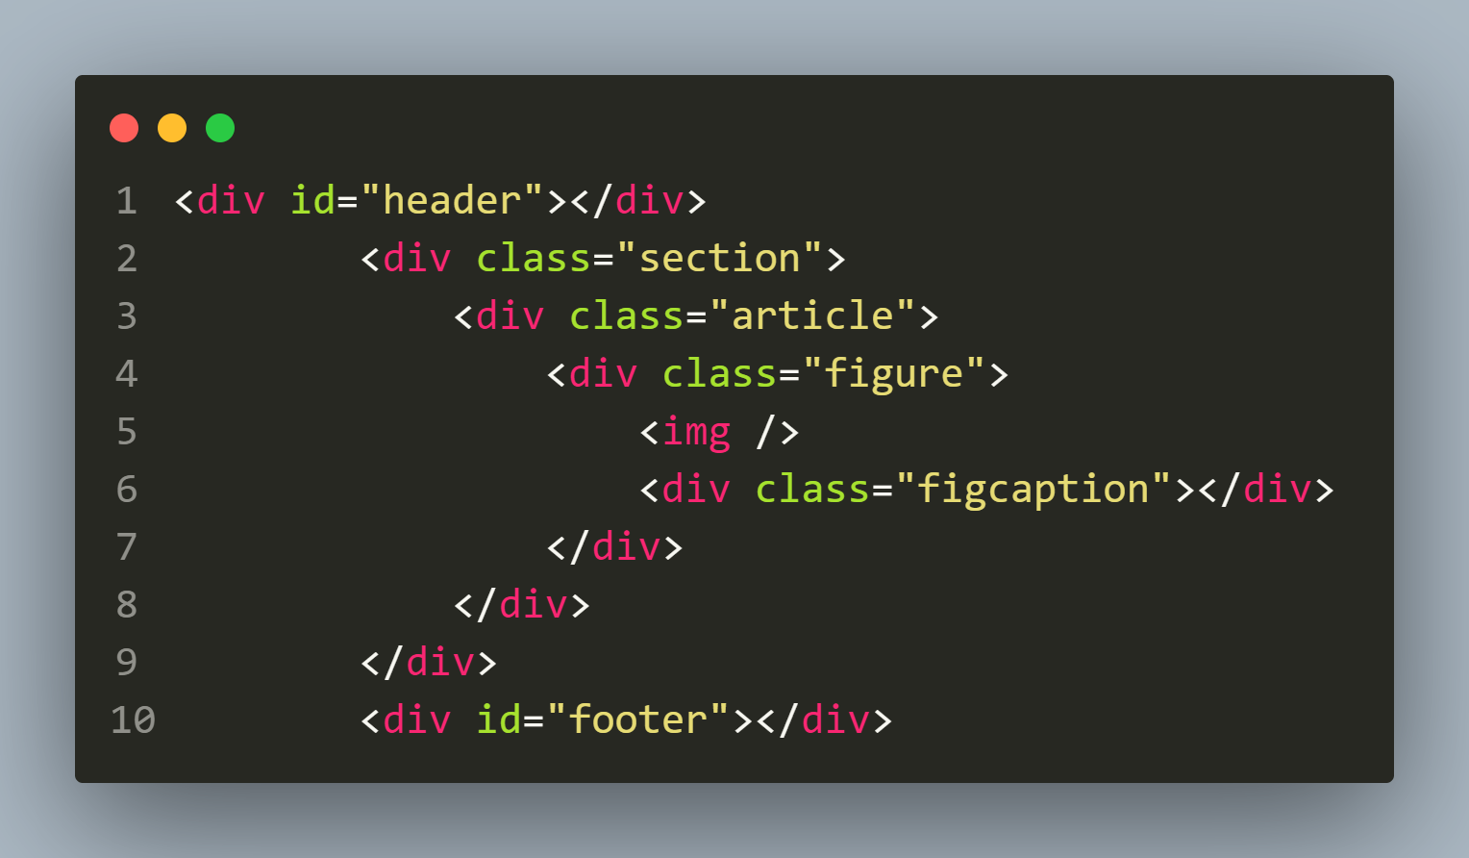
A Page Without Semantic Elements

Slide 12
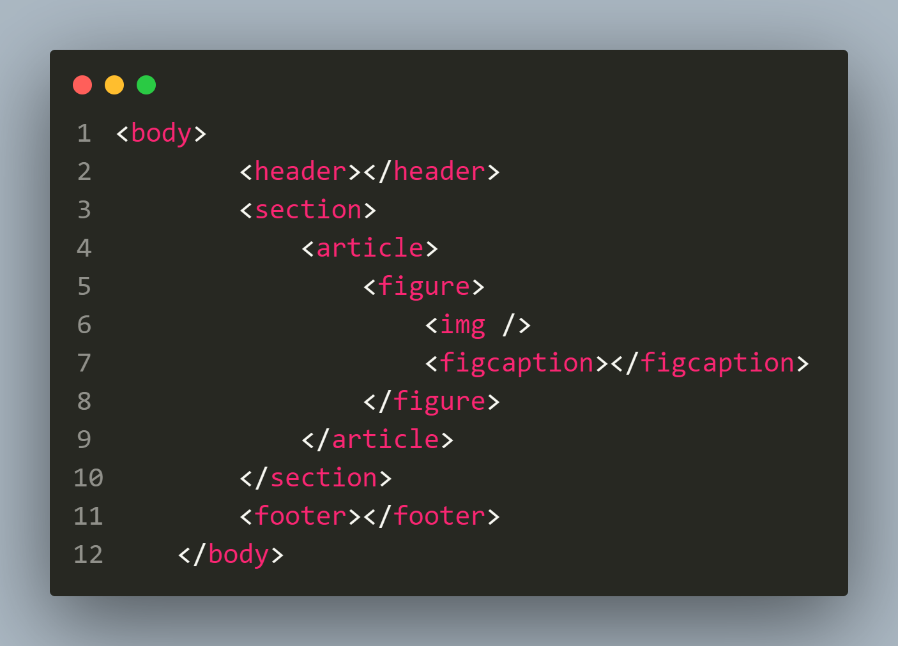
A Page With Semantic Elements

Slide 13
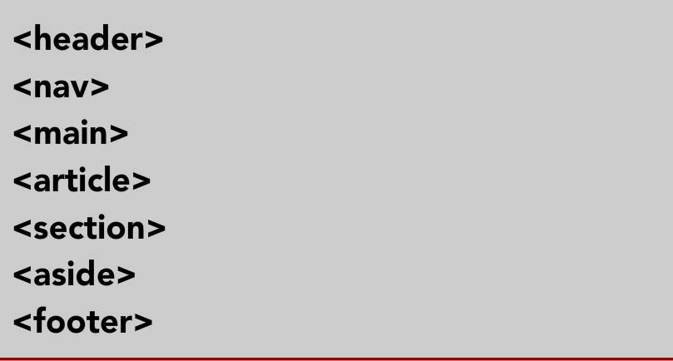
Popular HTML 7 Semantic Tags
Although we have many semantic tags , but the most common of them , which can be used in place of <div> are:

Slide 14
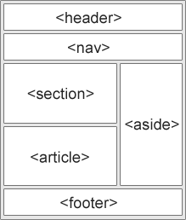
The <header> Tag
The <header> element defines content that should be considered the introductory information of a page or section.

Slide 15
The <nav> Tag
Main navigation menu links would all be placed in a <nav> tag.
However sub navigation menus elsewhere on the page could also use <nav> tag

Slide 16
The <main> Tag
The body of a page should go in the <main> tag – not sidebars and main navigation.
There should be only one per page.

Slide 17
The <article> Tag
The <article> tag specifies independent, self-contained content.
An article should make sense on its own

Slide 18
The <section> Tag
Using <section> is a way of grouping together nearby content of a similar theme.
A section tag differs to an article tag because it isn’t necessarily self-contained.

Slide 19
The <aside> Tag
An <aside> element defines content that’s less important.
It’s often used for sidebars – areas that add complementary but not vital information.

Slide 20
The <footer> Tag
We would use <footer> at the base of a page or section.
It might include contact information and some site navigation.

Slide 21
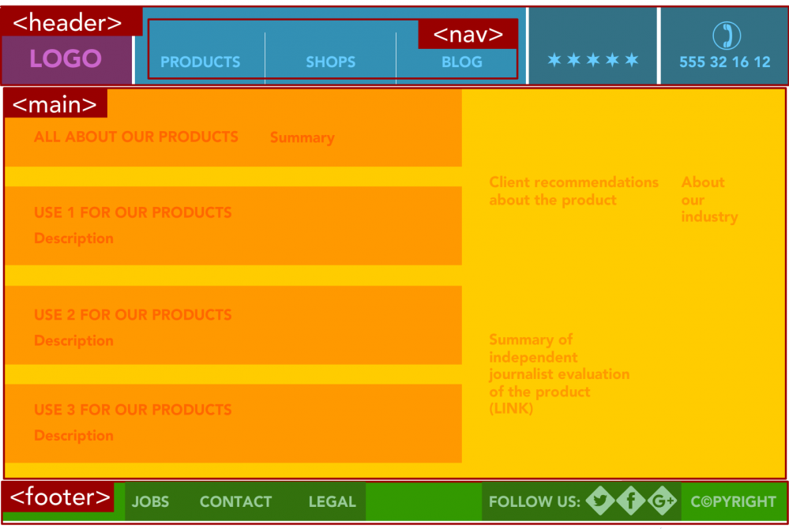
The Complete Picture

Slide 22
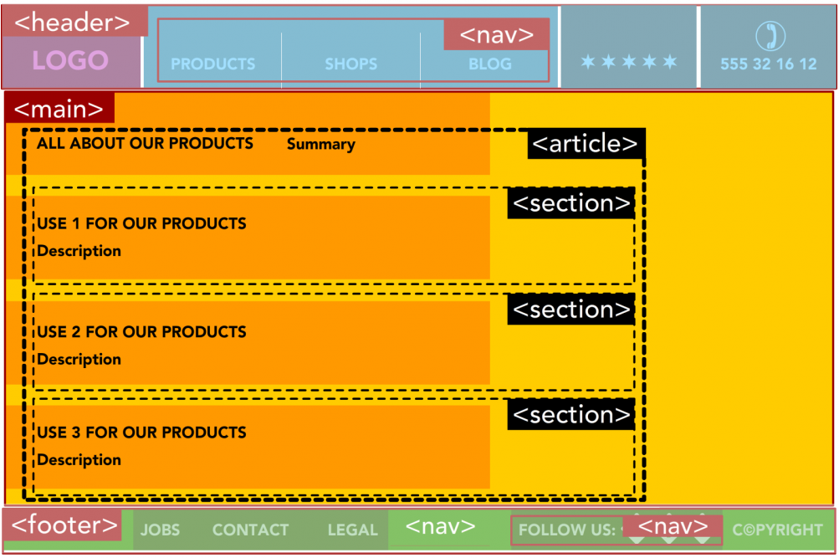
The Complete Picture

Slide 23

End Of Lecture
For any queries mail us @: scalive4u@gmail.com
Call us @ : 0755-4271659, 9826686245
Agenda for Next Lecture:
CSS Box Model

